Slide 1
STEM Lab
Franklin Lakes Public Schools
Grades 6-8

Slide 2
What is STEM?
Notes:
This video was completely made by the students-- all I asked was for a short clip about STEM class and this is what they made! So cute! They did this in about 20 minutes- including deciding what they wanted to say, how they wanted it formatted in iMovie, and how they wanted to organize their ideas.

Slide 3
Mission
Science Department Mission:
The Franklin Avenue Middle School Science department strives to create self-directed, enthusiastic, life-long learners. The science team wants to create scientists that have a desire to solve problems, question ideas, and actively engage in scientific inquiry.
STEM Lab Mission:
As an extension of the science department mission, the STEM Lab will provide Franklin Avenue Middle School students with opportunities to apply engineering and 21st century concepts and skills through collaborative, project-based learning experiences to enrich and extend the content of their core science courses. These experiences evolve in real time along with research and discoveries in the Sciences.

Slide 4
Curricular Design and Standards
21st Century Skills and Engineering and Science Practices:
Collaboration, Creativity, Problem-Solving, Critical Thinking, Brainstorming
MATH CONTENT
TECHNOLOGY
CONTENT
SCIENCE
CONTENT

Slide 5
Process to Inform Curriculum Design
Professional development, collaboration, and leadership:
College of New Jersey’s “How to Create a Middle School STEM Course”
Penn State University’s: Center for Science and the Schools Grant to Eileen Antonison: “BBEP: NewBio Teacher Workshop”
New Jersey Astronomy Center for Education
Next Generation Science Standards
Common Core State Standards
and more!
Notes:
STEAM vs. STEM:
Interdisciplinary, but does not need to explicitly say “Art,” but it’s automatically integrated it.
Articulation between Art Teacher and STEM Teacher: technical drawing, elements of design, careers. Relate this to every career readiness

Slide 6
The STEM Curriculum
Created to supplement science content area learning through hands on projects
Projects included may change as technology advances
Science Curriculum in revision will also incorporate STEM
Notes:
STEAM vs. STEM:
Interdisciplinary, but does not need to explicitly say “Art,” but it’s automatically integrated it.
Articulation between Art Teacher and STEM Teacher: technical drawing, elements of design, careers. Relate this to every career readiness.

Slide 7
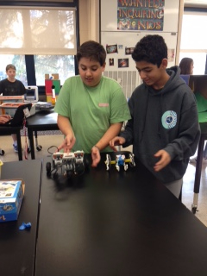
How do we Introduce STEM Topics?
Project Based Learning
Interdisciplinary Approaches
Incorporate Engineering Design
Technical Reading and Writing
Learning by Inquiry
Promote Innovation
Notes:
*Robotics being used in a context-- not building robots just to build them, but figuring out how to build robots that are integral to your overall project question

Slide 8
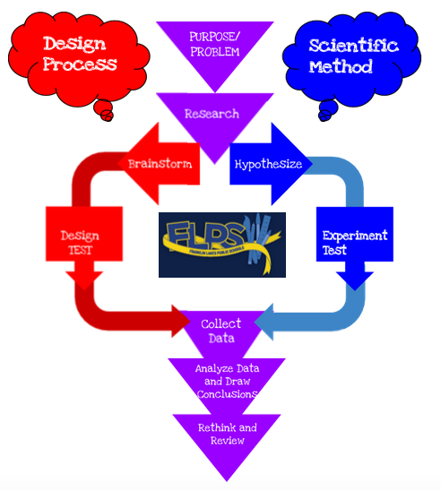
Processes
Franklin Lakes Science teachers developed this engineering design process. The process will be applied in all STEM content areas to organize thinking about engineering design and the scientific method, and to facilitate project completion.

Slide 9
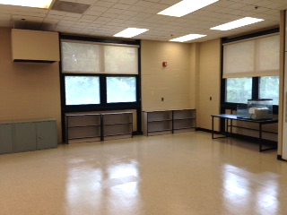
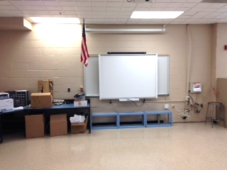
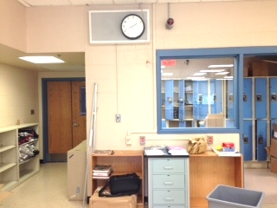
The STEM Lab- Before
Notes:
Just getting pics in here--- whiteboard tables that can be configured into different grouped shapes easily, lab tables on wheels to move around as needed...
Provide images and discussion of the renovation/ investment into the planning, purchasing, and preparation for the STEM lab.

Slide 10
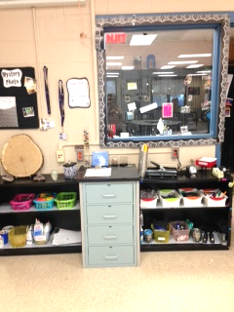
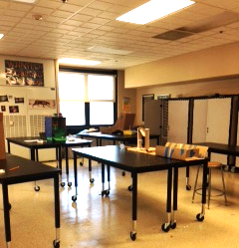
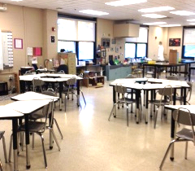
STEM Lab-After!
STEM Library
Computer Programming Station
The new STEM lab has trapezoid-shaped whiteboard tables that can be reconfigured daily and lab tables on wheels for additional classroom change and organization!

Slide 11
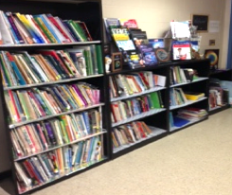
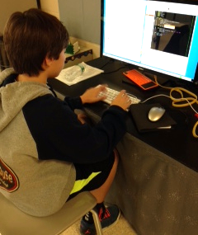
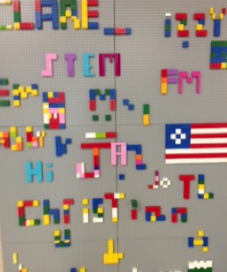
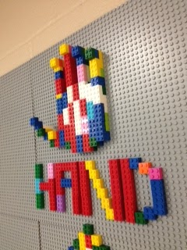
STEM Stations
The Lego Wall
was created to inspire creativity and fun! Students
also use it to practice their 3D isometric drawing skills!
STEM Library
Computer Programming Station
Notes:
I velcroed lego baseplates to the wall to create the vertical lego wall.

Slide 12
Grade 6: Science-STEM
6th Grade Science | 6th Grade STEM
Key Concepts Introduced in 6th Grade Science include: Exploration of the environment in space and astronomy Earth’s Rotation Tides Exploration of the Moon Exploration of the Scientific Method Introduction to Claims/Evidence and Reasoning | Key Concepts Introduced in 6th Grade STEM include: Focus on Engineering in Space Possible project topics: mars rover, satellite technology, space exploration, space station, rocketry Possible introduction to coding through exploration of these topics. Introduction to design process, design challenges, and areas of technology

Slide 13
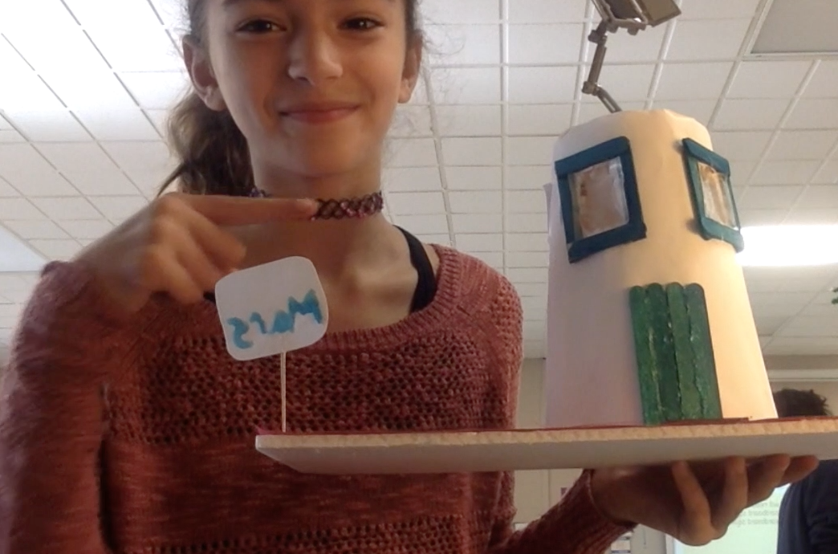
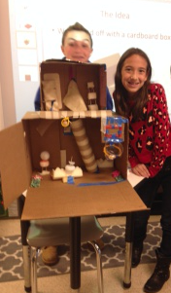
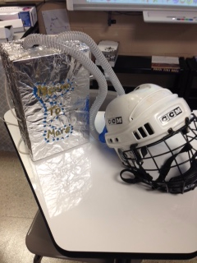
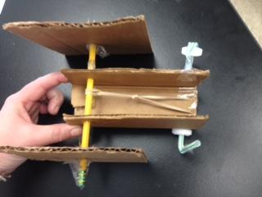
Grade 6 Sample Activity
Space Design
Students learned about space exploration by building and redesigning Mars Rovers
Students learned about future missions to Mars and designed projects to meet the needs of people who might travel to and live there
Notes:
Students also learned how to code in Scratch. Students also learned about satellites, digital images, properties of light, and communications.

Slide 14
Grade 7: Science-STEM
7th Grade Science | 7th Grade STEM
Key Concepts Introduced in 7th Grade Science include: Advanced Understanding of topics in biology Exploration of systems of living things Cells: structure and function Cell Processes: Photosynthesis Adaptations and ecology | Key Concepts Introduced in 7th Grade STEM include: Focus on areas of Biotechnology and Bioengineering in medical and agricultural fields Possible project ideas: Designing a photobioreactor or hydroponic system Bioproducts or biomimicry 'Repairing a femoral artery' design (coding with possible application to the arduino board, possible robotics in medical tech applications)

Slide 15
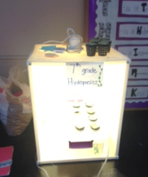
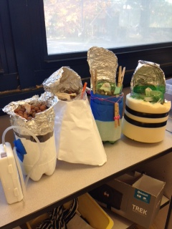
Grade 7 Sample Activity
Hydroponics Design Challenge
Students learned about gardening with hydroponics and grew basil from seeds as a class. With their groups, they designed and tested hydroponic chambers that could support one plant each.
Notes:
The other big topic was a BIomimicry Design challenge- students looked for inspiration from nature and studied adaptations to answer an engineering question.

Slide 16
Grade 8: Science-STEM
8th Grade Science | 8th Grade STEM
Key Concepts Introduced in 8th Grade Science include: Introduction to Energy, Machines and Motion. Extensive exploration of energy and motion through exploration of: Simple Machines Law of Conservation of Energy Hooke’s and Newton’s Laws Mechanical Advantage | Key Concepts Introduced in 8th Grade STEM include: Focus on engineering and physical science (electrical, structural, mechanical...) Projects can include: Creating Electrical circuits (applying coding to circuits with the makeymakey) LED Light design challenge Rube Goldberg Energy Transfer Challenge Transportation (solar cars, maglev, etc)

Slide 17
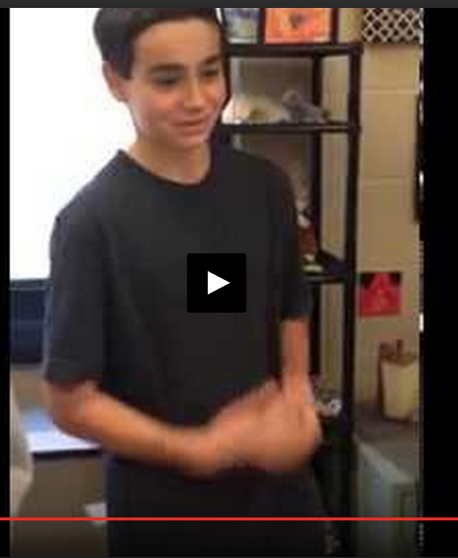
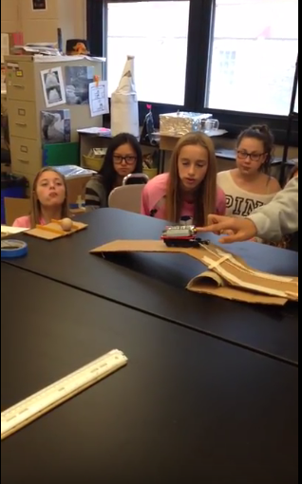
Grade 8 Sample Activity
Rube Goldberg Devices
Notes:
To understand more about simple machines, students were grouped by interest and had a choice between Rube Goldberg devices, marble roller coasters, and carnival games.

Slide 18
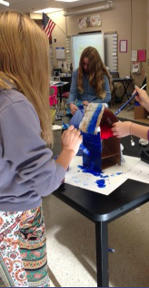
How do we assess learning?
Design Process Rubrics
Completion of Portfolios
Claims, Evidence, Reasoning
Scientific Journaling
Technical Drawings
Self-evaluation and group assessments
Student Reflections
Blog/digital journals
Notes:
I create rubrics with the students to give them ownership. I consult rubrics from other grade level subjects to pull elements and reinforce concepts and skills.

Slide 19
Thank You!
With Special Thanks to our
STEM Lab Teacher/ Curriculum Writer, Ms. Eileen Antonison

